Slide 1
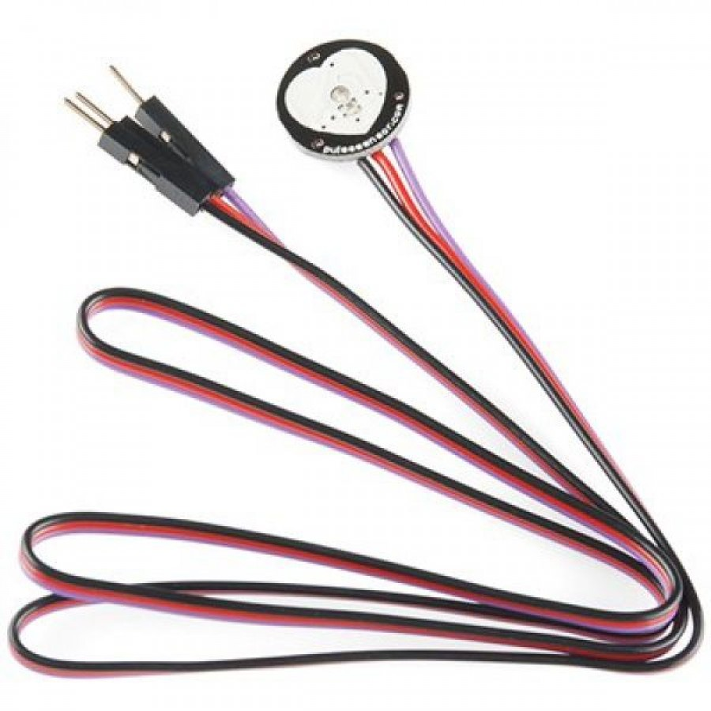

Pulse Sensor: Breathalyzer By: Karandeep Singh

Slide 2
Introduction: (Proposal)
Purpose : To help fix the problem of drinking and driving. The amount of drunk drivers need to be reduced around the world.
Working : Checks the heartbeat reading of the user and warns him/her to keep a check on it.
My team : Mohita Prabhakar and Maheshwarie Samaroo

Slide 3
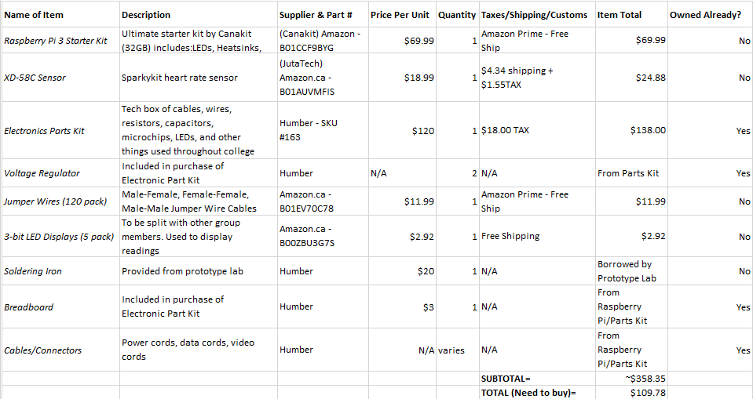
Budget:

Slide 4
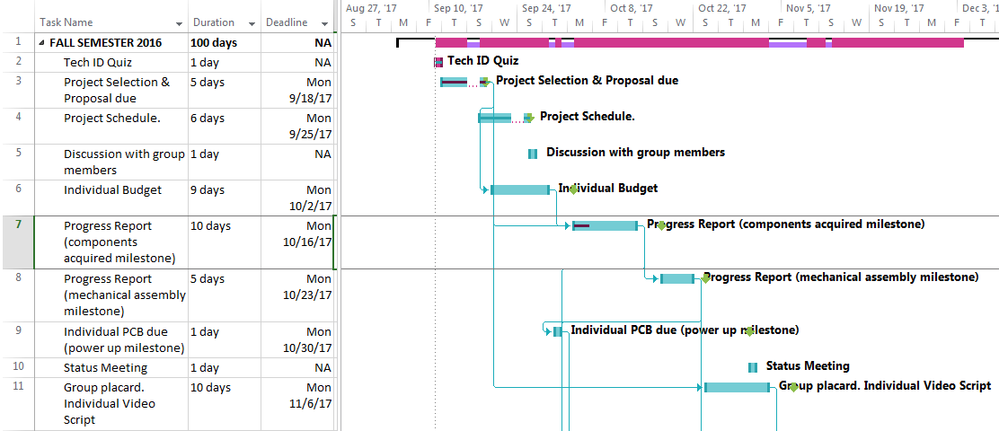
Schedule:

Slide 5
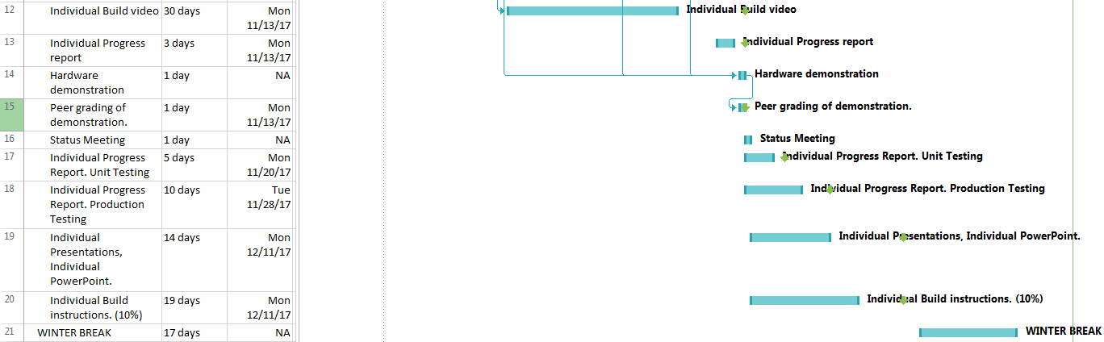
Schedule:

Slide 6

Build Video:

Slide 7
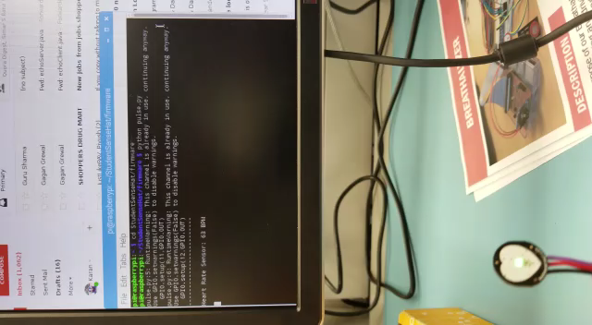
Proof it Works

Slide 8
Knowledge from previous courses
TECH 101 – Electric Circuits & TECH 150 – Electronic Devices and Circuits How to properly test circuits and see how to get readings.
TECH 153 – Technical C – Learned to use Raspberry Pi
CENG 215 – Digital and Interfacing Systems – Learned about sensors
CENG 216 – Intro to Software Engineering -Got familiar with making budgets and were introduced to the use of GANTT charts.

Slide 9
Thank you

